Slide 1
SQL

Slide 2
About SQL
MySQL is the most popular open source relational database system.
MySQL is a cross-platform and first released in 1995.
The database is a collection of data.
To create, delete, update, insert.
SQL stands for structured query language an is a computer language that we use to interact with a relational database.

Slide 3
Some Bacis of SQL
Creating a Database: You can create a new database using the CREATE DATABASE command.
Creating Tables: You can create a table in the database using the CREATE TABLE command.
Inserting Data: You can insert data into tables using the INSERT INTO command.
Querying Data: You can retrieve data from the database using the SELECT command.
Updating Data: You can update existing data in the database using the UPDATE command.
Deleting Data: You can delete data from the database using the DELETE command

Slide 4
Keys in DBMS
Super key
Candidate Key
Primary Key
Alternate Key
Secondary Key
Foreign Key

Slide 5
Keys in DBMS
Primary Key
A table/ Relation can have only one primary key allowed. Primar key is should uniquely and non null keys allowed.
Candidate Key
Candidate keys are a subset of super keys. Multiple candidate keys are allowed. No repeated Attributes For Ex (Student_ID, Roll_no)
Super Key
Set of one or more attributes that allows identifying an entity uniquely. (For Ex) (Student_Id, Student_Name,Roll_no,Email_id)

Slide 6
Keys in DBMS
Alternate Key
Alternate Key or Secondary Key (Primary Key - Candidate key)
Foreign Key
A foreign key is a reference key. foreign key is a key used to link two tables together.
Foreign key is used to maintain relationship between two tables.

Slide 7
MYSQL Main Commands
Create database (Create a New Database)
Show Database (View Databases)
Drop Database
Alter Database (Modify Database)
Create Tables
Show tables
Insert Values
Drop Table
Alter table ( For New Column Creation)
Alter Table Modify
Alter table Drop ( Drop the Column)
Alter table Rename (Rename the Table)
Update Table ( To change the Values)
Delete Statement

Slide 8
Trigger
What is trigger
A database trigger is a stored program which is automatically
fired or executed when some events occur.
Types of Trigger
Row level Trigger -A event is triggered at row level for each row updated, inserted or deleted.
Statement Level trigger -An event is triggered at table
Level for each sql statement executed

Slide 9
Triggers Timings
before insert
after insert
before update
after update
before delete
after delete

Slide 10
My SQL General Functions
Where
or
and
in
Not in
>
<
>=
<=
<> (Not equal to)
!
Count
Distinct
Count With Distinct
Order by Asc
Order By Desc
Group By
Limit
Desc Limit
Like (_%)
Not like
Between

Slide 11
MY SQL Calculate Functions
- Sum
- Average
- Min
- Max
- Count
My SQL Date Functions
- Date ADD
- Datediff
- Timestamp DIff
- Date Format
- Year
- Day
- Month
- Now
My SQL String Functions
- LCase
- UCase
- Left
- Right
- Concat
- Trim
- Char_Length
- Mid
- Length

Slide 12
How to create procedures in SQL?
A stored procedur is a prepared sql code that you can save, so the code can be reused over and over again.
So if you have an SQL query that you write over and over again,save it as a stored procedure, and then just call it to execute it.
(For Ex) Create procedure
SelectAllcustomers AS
Select * from Customers
GO;
Exec Selectallcustomers;
Advantages
Decrease the Network traffic
Centralize Business Logic For ex (If and or
ElseIF)
Fully secured
Disadvantages
Resource usage
Hard to maintain

Slide 13
Logical Functions
- IF
- If with and conditons
- If with or conditions
- Count If
Join Queries
- Inner Join
- Left Join
- Right Join
- Cross join
- Full Outer Join
- Case and end
- when
- then
- double case with end statement
- case with and statement
- case with or statement
- RDBMS with subqueries
- having clause
- basic joins Trigger (Create table after connections)
RDBMS System
-Two table connection
-Three table connection

Slide 14
Procedures concepts (SQL Automation)
- Procedure creation
- Begins & end
- call Procedures
- Alter procedures
- Declering variables
- Store variables
Triggers (SQL Automation)
- trigger creation
- trigger timings
- before insert
- after insert
- before update
- after update
- before delete
- after delete
- Trigger with if statement
- trigger with else if statement

Slide 15
Pl SQL - Procedural language Structured Query language
- Procedures
- Functions
- Loops
- Variables
- Triggers

Slide 16
Creating Database
Starting with creating database is necessary while creating an table in the sql.
Then applying the use quary make the table.
The following slide shows the sql basics.

Slide 17
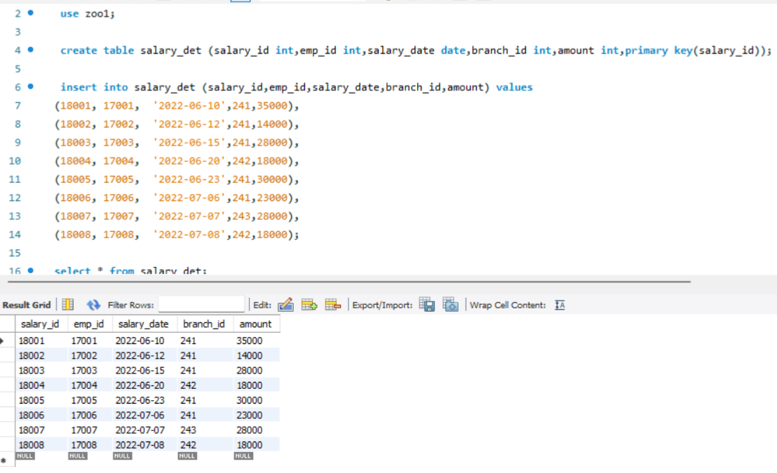

Slide 18
Starting with creating database is necessary while creating an table in the sql.
Then applying the use quary make the table.
The following slide shows the sql basics.

Slide 19
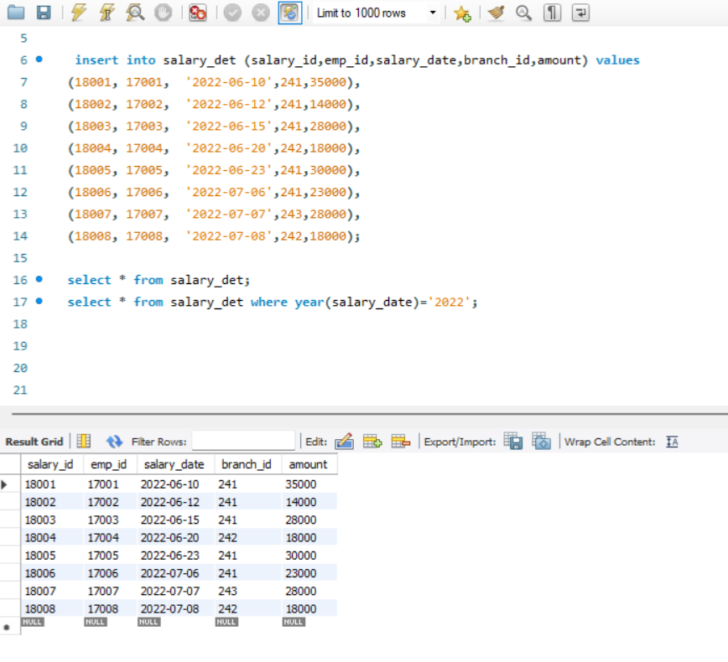

Slide 20
Starting with creating database is necessary while creating an table in the sql.
Then applying the use quary make the table.
The following slide shows the sql basics.

Slide 21
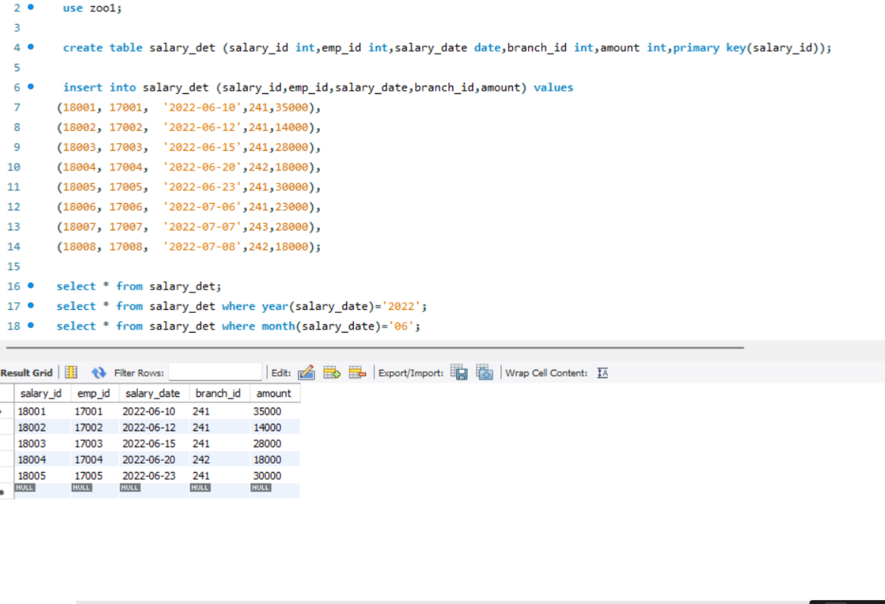

Slide 22
Starting with creating database is necessary while creating an table in the sql.
Then applying the use quary make the table.
The following slide shows the sql basics.

Slide 23
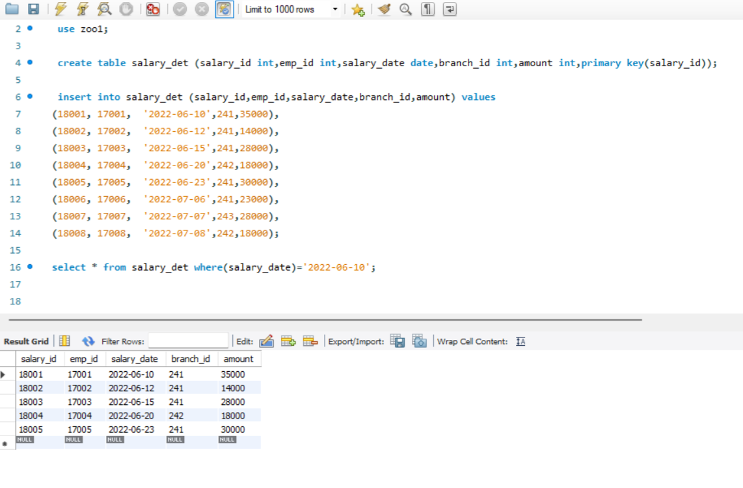

Slide 24
Starting with creating database is necessary while creating an table in the sql.
Then applying the use quary make the table.
The following slide shows the sql basics.

Slide 25
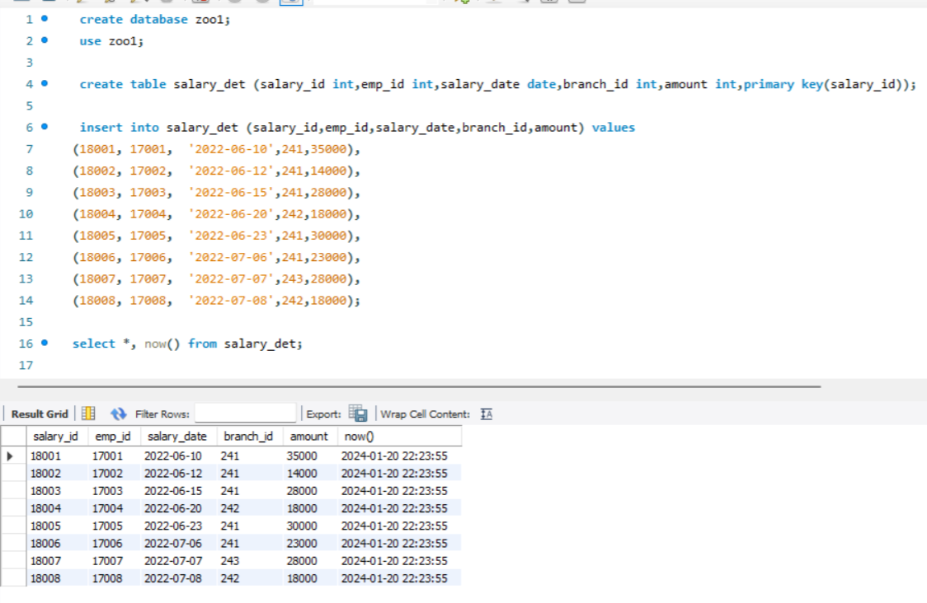

Slide 26
Starting with creating database is necessary while creating an table in the sql.
Then applying the use quary make the table.
The following slide shows the sql basics.

Slide 27
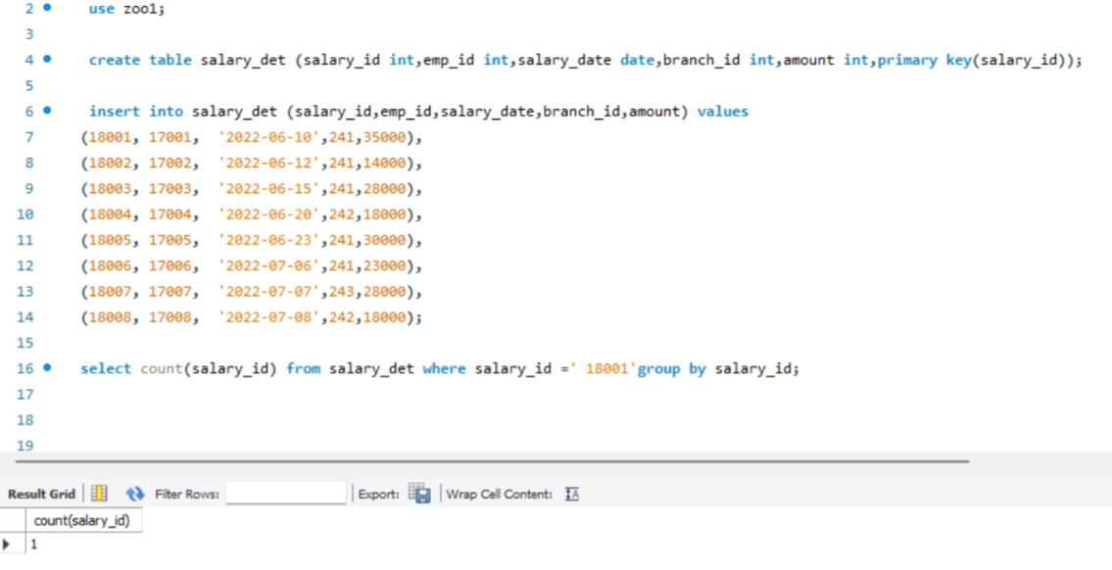

Slide 28
Starting with creating database is necessary while creating an table in the sql.
Then applying the use quary make the table.
The following slide shows the sql basics.

Slide 29
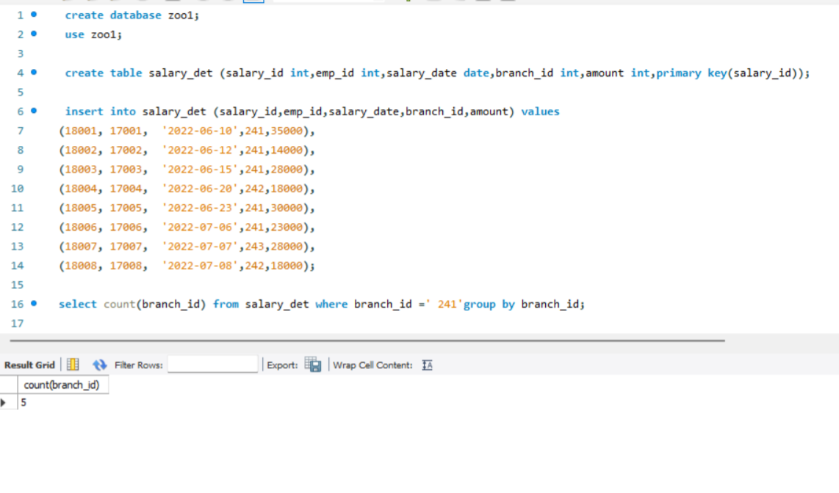

Slide 30
Starting with creating database is necessary while creating an table in the sql.
Then applying the use quary make the table.
The following slide shows the sql basics.

Slide 31
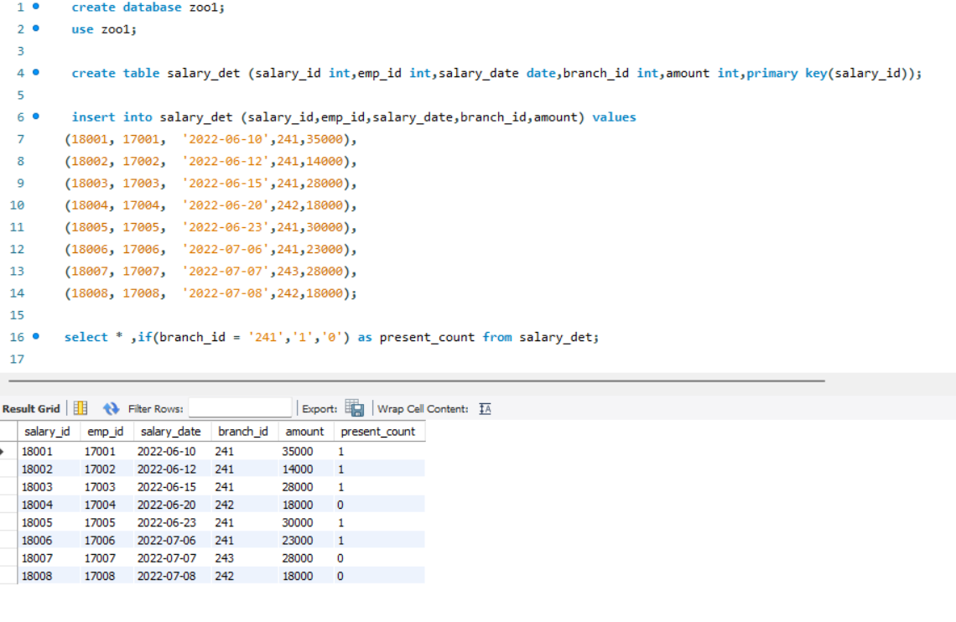

Slide 32
Starting with creating database is necessary while creating an table in the sql.
Then applying the use quary make the table.
The following slide shows the sql basics.

Slide 33
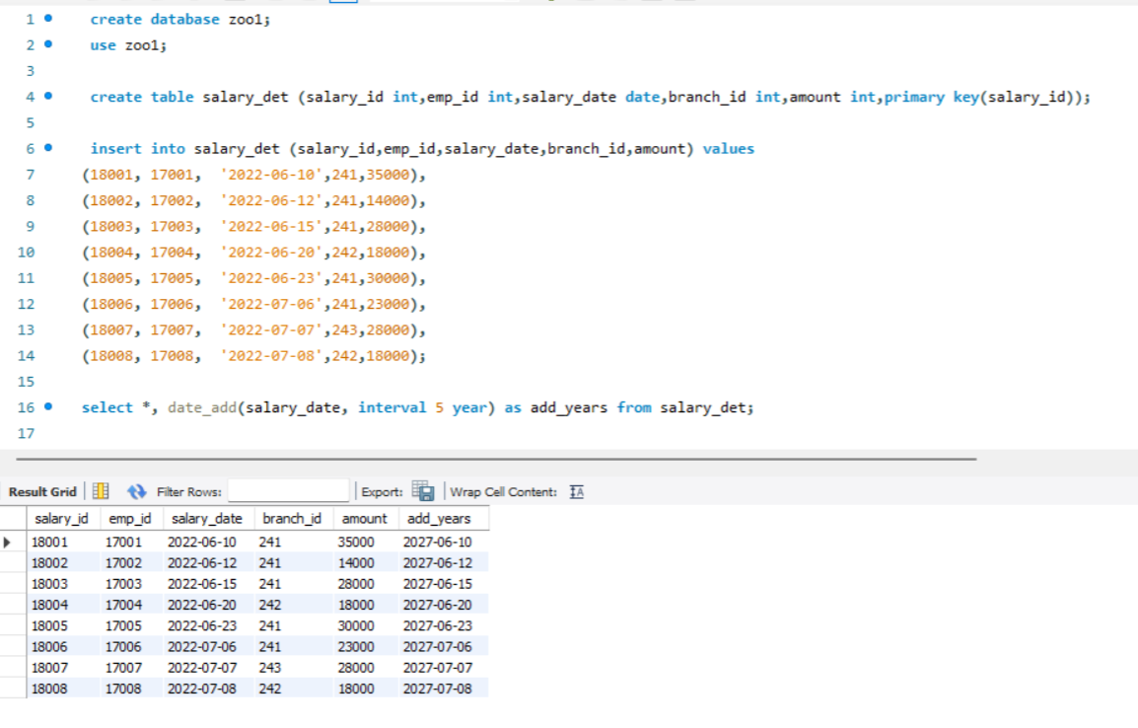

Slide 34
Starting with creating database is necessary while creating an table in the sql.
Then applying the use quary make the table.
The following slide shows the sql basics.

Slide 35
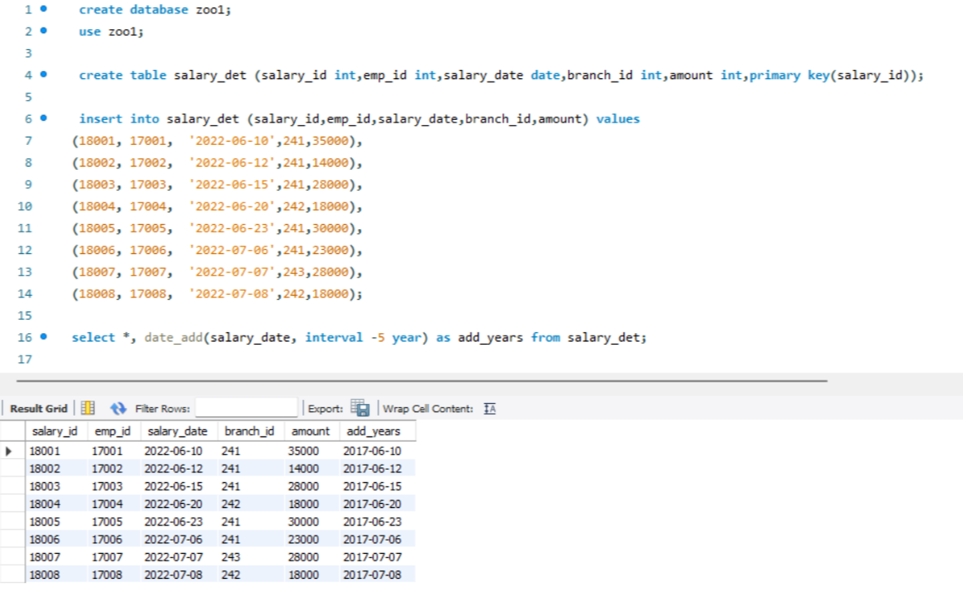

Slide 36
Starting with creating database is necessary while creating an table in the sql.
Then applying the use quary make the table.
The following slide shows the sql basics.

Slide 37
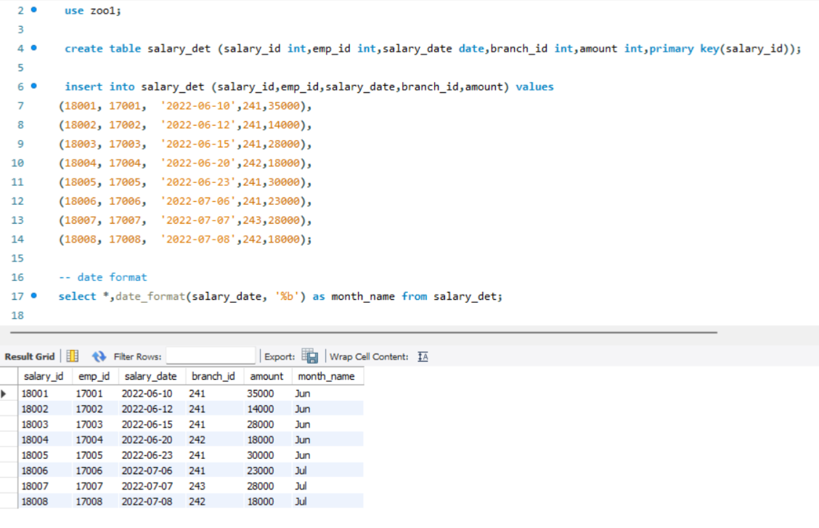

Slide 38
Starting with creating database is necessary while creating an table in the sql.
Then applying the use quary make the table.
The following slide shows the sql basics.

Slide 39
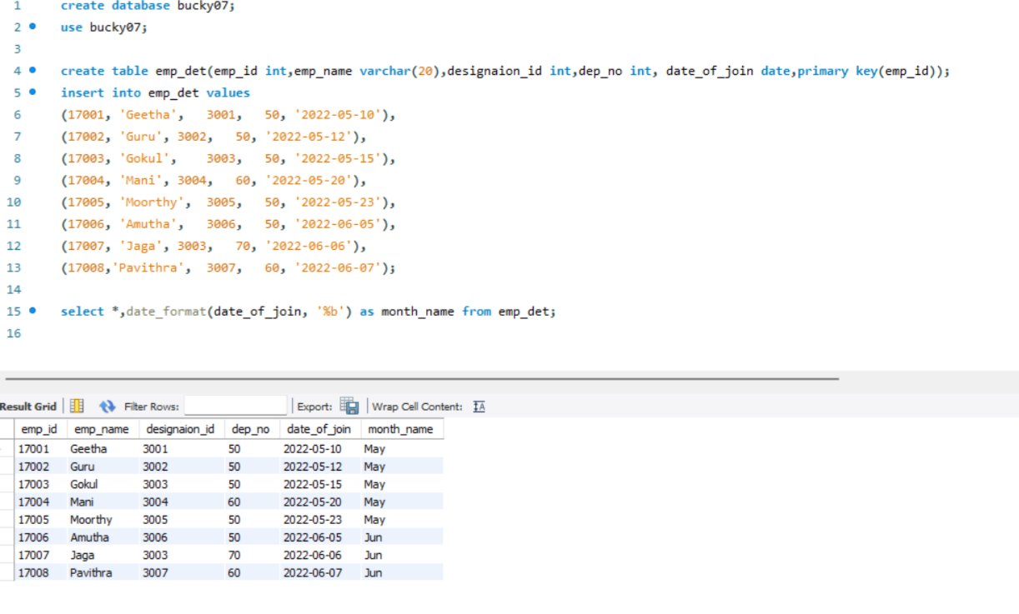

Slide 40
Starting with creating database is necessary while creating an table in the sql.
Then applying the use quary make the table.
The following slide shows the sql basics.

Slide 41
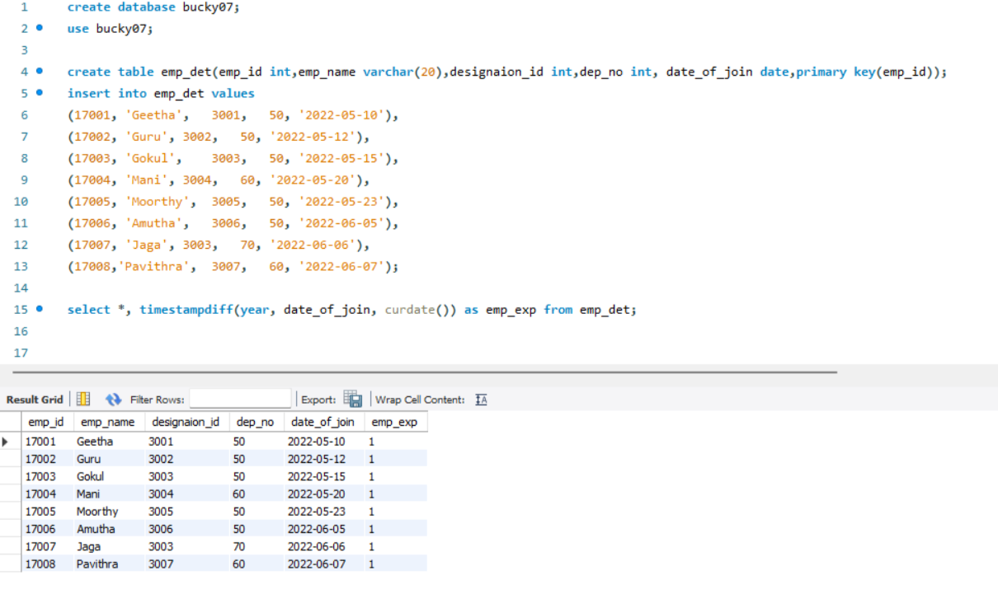

Slide 42
Starting with creating database is necessary while creating an table in the sql.
Then applying the use quary make the table.
The following slide shows the sql basics.

Slide 43
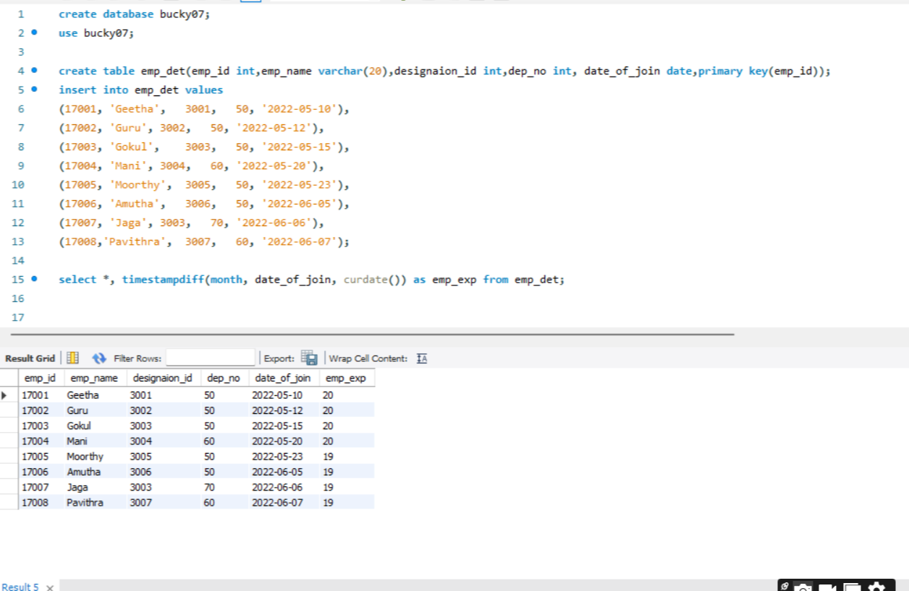

Slide 44
Starting with creating database is necessary while creating an table in the sql.
Then applying the use quary make the table.
The following slide shows the sql basics.

Slide 45
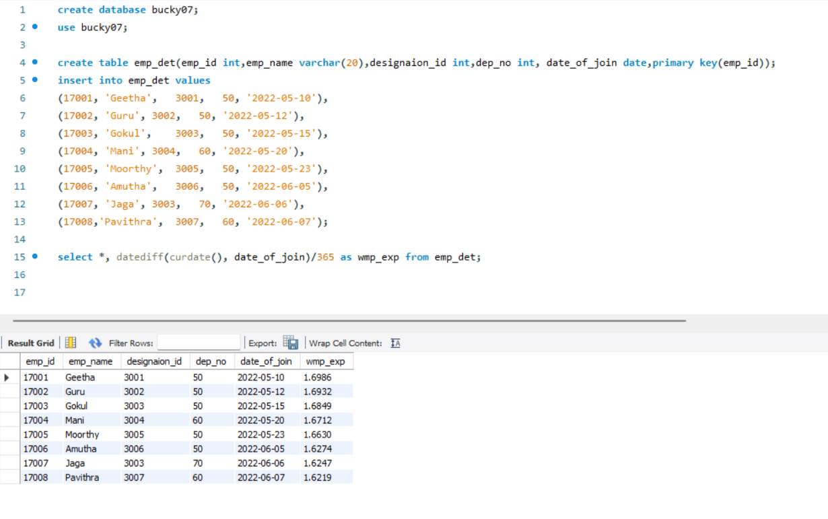

Slide 46
Starting with creating database is necessary while creating an table in the sql.
Then applying the use quary make the table.
The following slide shows the sql basics.

Slide 47
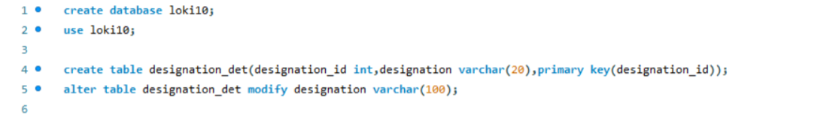

Slide 48
Starting with creating database is necessary while creating an table in the sql.
Then applying the use quary make the table.
The following slide shows the sql basics.

Slide 49
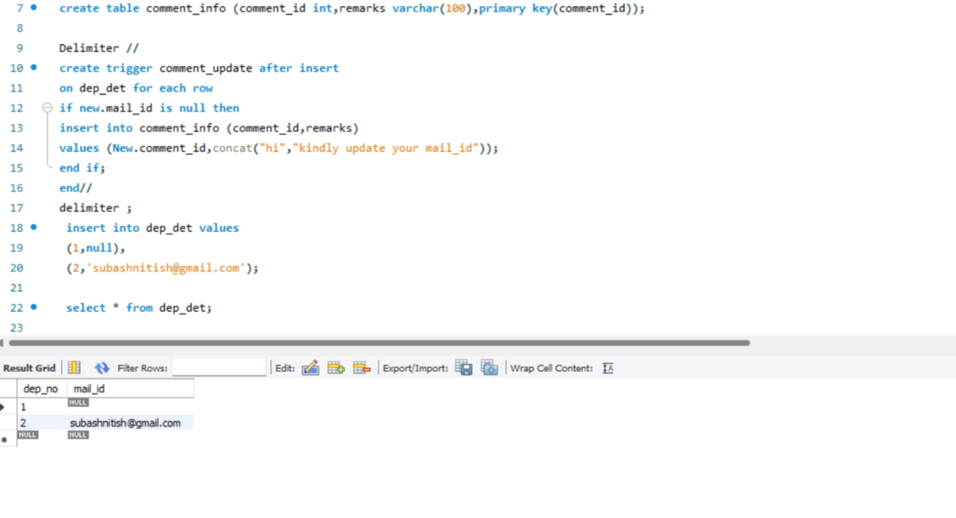

Slide 50
Starting with creating database is necessary while creating an table in the sql.
Then applying the use quary make the table.
The following slide shows the sql basics.

Slide 51
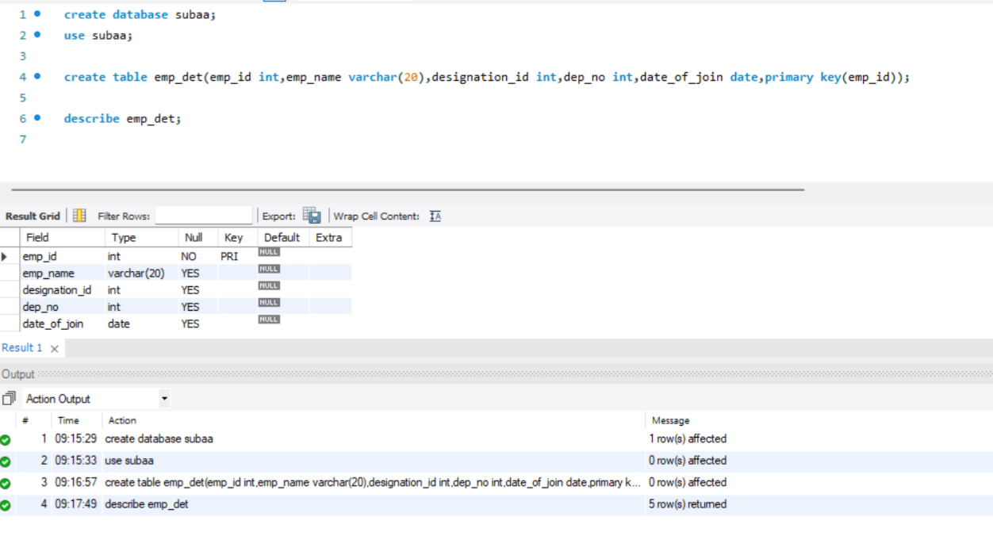

Slide 52
Starting with creating database is necessary while creating an table in the sql.
Then applying the use quary make the table.
The following slide shows the sql basics.

Slide 53
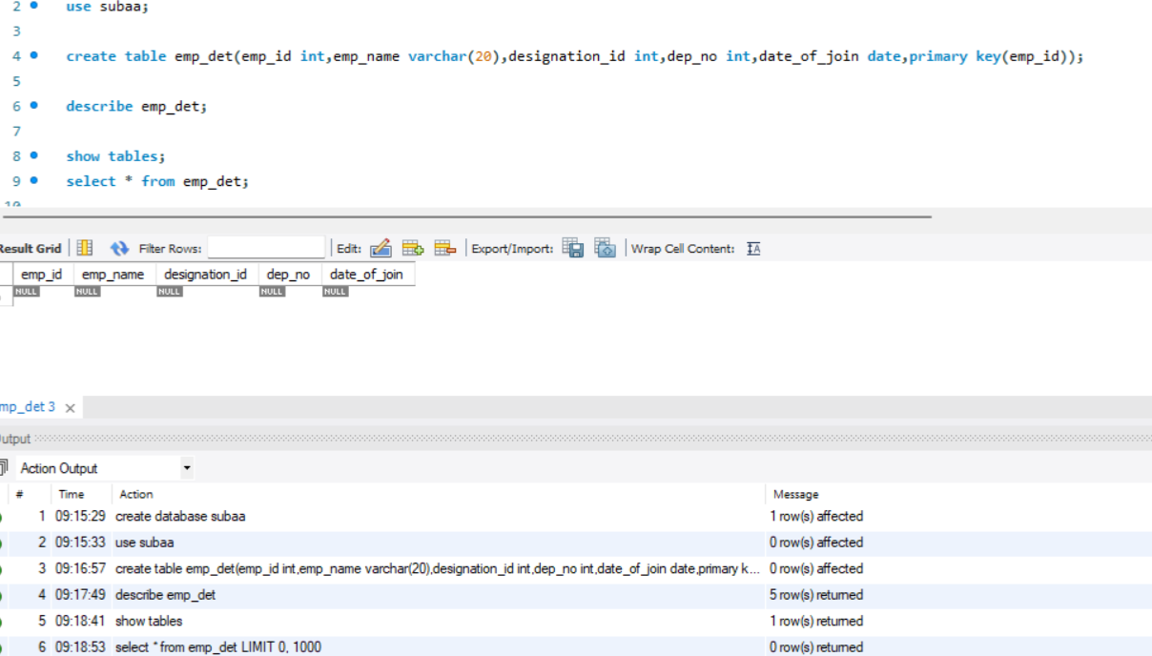

Slide 54
Starting with creating database is necessary while creating an table in the sql.
Then applying the use quary make the table.
The following slide shows the sql basics.

Slide 56
Starting with creating database is necessary while creating an table in the sql.
Then applying the use quary make the table.
The following slide shows the sql basics.

Slide 57
SOME SQL Questions:
1. How to Create Tables in Sql?
The Colum Parameters specify the names of the columns of the table.
The datatype parameter specifies the type of data the column can hold (Eg. varchar, integer,date etc).
(For Ex)
Create table persons (Persons_id int,Lastname varchar(255), firstname varchar(255),Address varchar(255), city varchar(255));
Primary key is mandatory, it is used for identify the particular Row.

Slide 58
3.How to create procedures in SQL?
A stored procedur is a prepared sql code that you can save,
so the code can be reused over and over again.
So if you have an SQL query that you write over and over again,
save it as a stored procedure, and then just call it to execute it.
(For Ex)
Create procedure
SelectAllcustomers
AS
Select * from Customers
GO;
Exec Selectallcustomers;

Slide 59
SENTHILNATHAN S

